Slide 1
Small Scale Nuclear Generation and Nuclear Batteries
By Eric Mulshine
NPRE 477: Energy Storage
University of Illinois Urbana Champaign
Spring 2021
Notes:
0:15

Slide 2
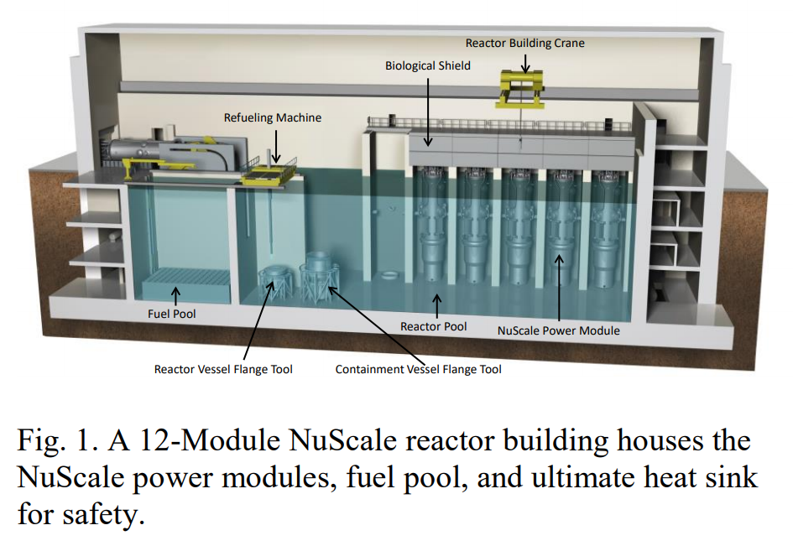
What is Small Scale Nuclear Power?
Replaces conventional baseload power sources like nuclear and coal
Takes advantage of economies of Scale
1 unit = 60MWe and 12 units in a module
Module can run in Island Mode completely isolated from grid
Can remain in operation during refueling
Not reliant on Microprocessors
Black Start Capable
Eric Mulshine University of Illinois Urbana-Champaign emulshine17@gmail.com
https://www.nuscalepower.com/technology/technical-publications
Notes:
(1:30)
New Concept being implemented by NuScale
Replaces traditional Nuclear plants
Small design allowes for reactors to be built in one factory and shipped
Takes advantage of econimeis of scale
12 Units to create a single module
60MWe * 12 = 720MWe capacity
Submerged in water
Creates a large thermal sinks
Can Run independently of Grid
Can have continuous operation
Even during refueling can operate all but 4 days of 60 year lifespan
Can support all of the modules using 50-100MWe for entire life time independent of the grid
Resistant to All types of natural disasters
Since there is not Computer reliance there are not vunerable to cyber attacks
And Is capcable of black start which means they can start cold without the use of the outside grid

Slide 3
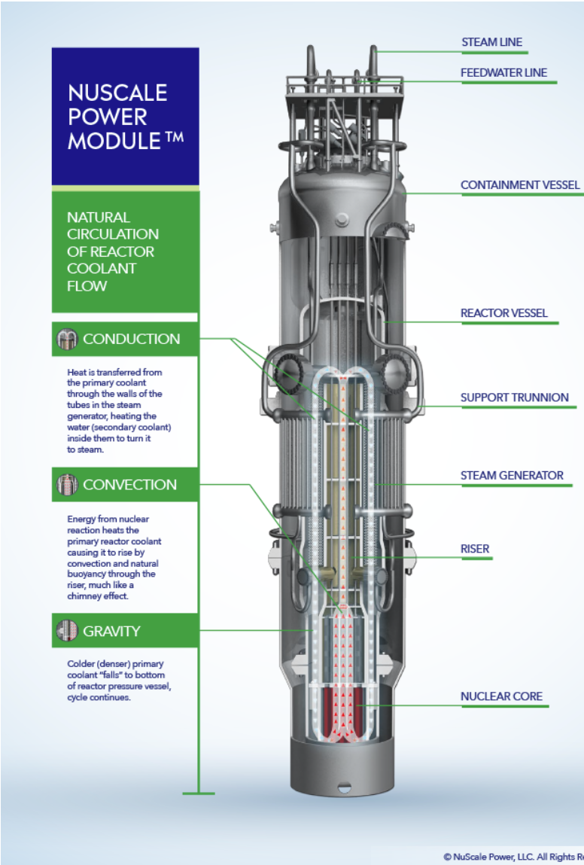
NuScale’s Light Water Reactor
Similar to traditional LWR reactors
Uses natural forces
Creates a negative feedback loop
Higher the temperature faster the cooling
Walkaway Passive Cooling
Reduced $T_{hot}$
Reduces stress on pressure vessel
Increases safety
Low SCRAM Rates and redundant systems
Eric Mulshine University of Illinois Urbana-Champaign emulshine17@gmail.com
https://www.nuscalepower.com/benefits/simplified-design
Notes:
1:00
This is a single unit
Fuel is at the bottom
Takes advantage of Convection
Conduction
Gravity to
Creates negative feed back loop
The hotter the fuel gets the faster convection and conduction moves heat out of the system
Prevents meltdowns and allows for walkaway standard
Since it relies on natural forces it can run with less energy inputs
Allows for passive cooling
Runs at lower temperatures
Decreases Carnot effecney
But increase safety and allows for completely passive cooling in reactor building
No Need for AC or DC power or any computer action
Can cool itself indeffinitly
Water does not need to be added for 5 months
Since Core is at the bottom of the pool there is a large amount of shielding to prevent radiation from reaching the workers

Slide 4
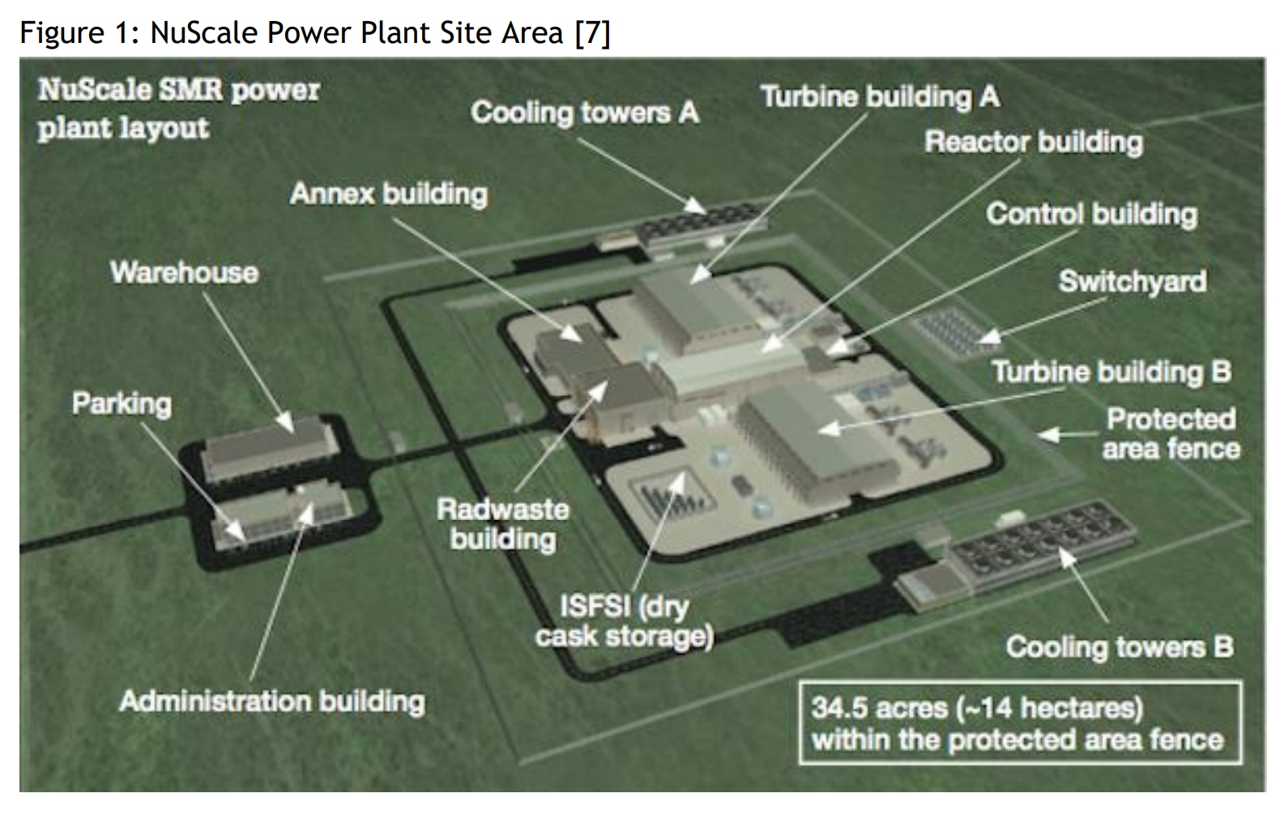
Small vs Large Scale Nuclear Production
Traditional Large Scale Nuclear plants | Small Scale Nuclear Generation
6-8 years to construct | 4 years construction
Not load following | Load following
No potential for expansion | Ability to add capacity as needed
Higher Carnot Efficiency | Lower temperatures allow for safer operation and passive cooling
Higher production of High-level Nuclear waste | Uses mixed uranium-plutonium oxide fuel (MOX)
2.58999 square km footprint per 1000MW plant | 0.14 Square km footprint per 720MW plant
Eric Mulshine University of Illinois Urbana-Champaign emulshine17@gmail.com
https://www.nuscalepower.com/technology/technical-publications
Notes:
3:30
Initial Capital investment
Small Scale reduces initial capital cost
Quicker time reduces interest accrued
Faster Return on investment Time
Allows for more modern grid capabilities
Load following
Finer ability to scale suppy
Allow for future increases in capacity
Increased safety
Reduced nuclear proliferation through the use of spent fuel

Slide 5
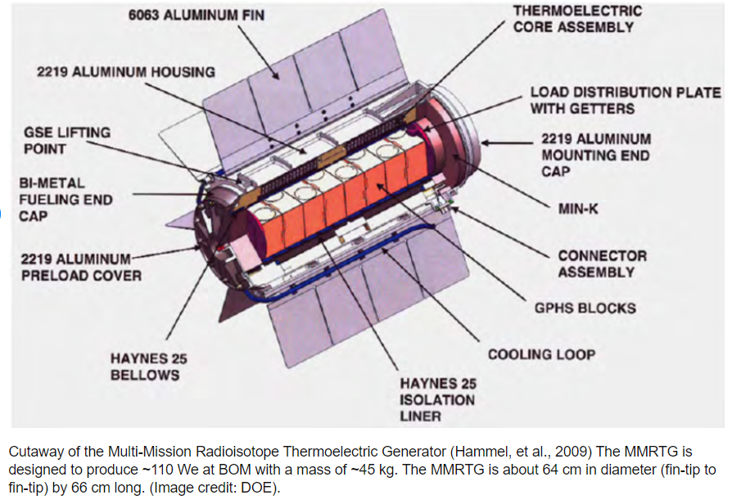
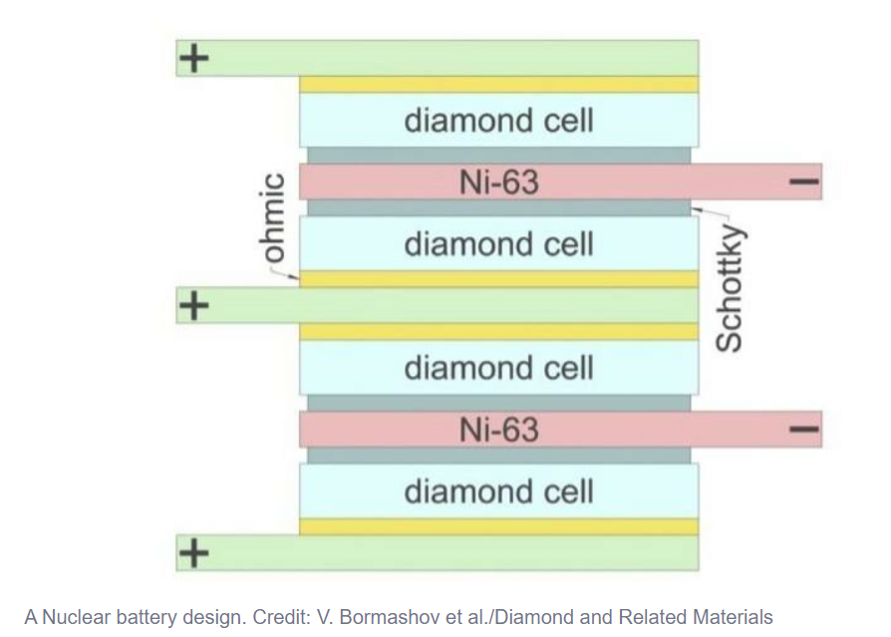
What are Nuclear Batteries
Radioisotope Thermoelectric Generators (RTG)
Use heat from absorbed decay
Heats water coolant for heat or electric production
Efficiency of around 0.5 to 1%
Not Actually batteries
Have similar applications
Large specific energy's
Long lifetimes
Use full for systems that need constant power
Betavoltaic power sources (BPS)
Similar to PV solar cell
Uses P and N type materials
Efficiency of around 5-8%
Eric Mulshine University of Illinois Urbana-Champaign emulshine17@gmail.com
Notes:
2:00
2 main designs
uses thermal energy to produce electricity such as with a sterling engine
Uses beefy PV cells to turn ionizing radiation into electric energy
Diamonds?
It looks like they just absorbed the decay particles with some diamond that have a high cross section. Then electricity some how
Fuck’in magic

Slide 6
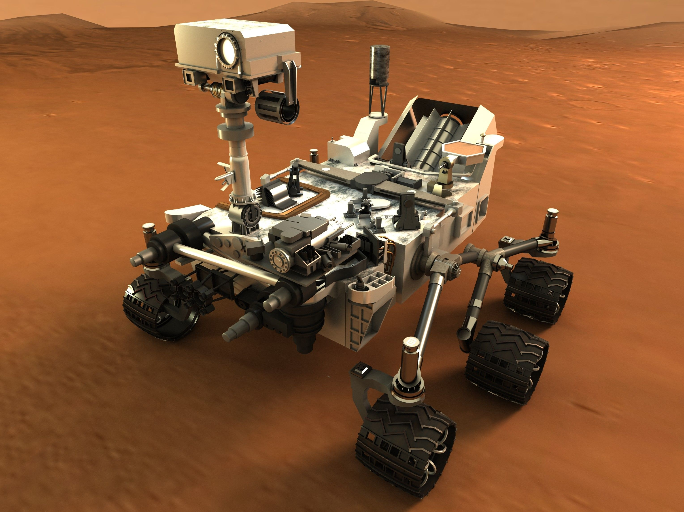
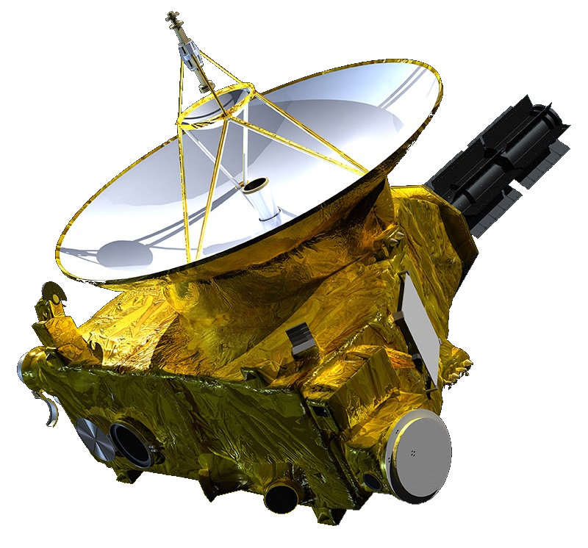
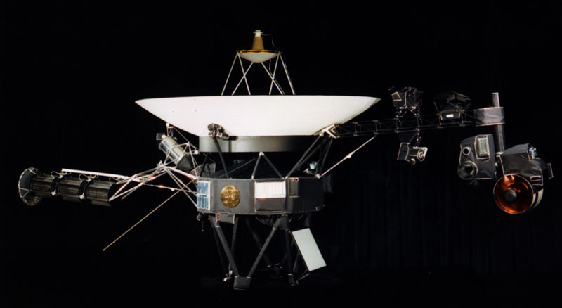
Some Space stuff
Long Lifetimes
Low maintenance
High specific energy
Uses${}_{}^{238}{Pu}$ as fuel
Notable Use
Ulysses
Galileo
Cassini-Huygens
New Horizon
Curiosity rover
Perseverance Rover
Voyager I and II
Eric Mulshine University of Illinois Urbana-Champaign emulshine17@gmail.com
Notes:
1:00
.8% degradation in capacity per year

Slide 7
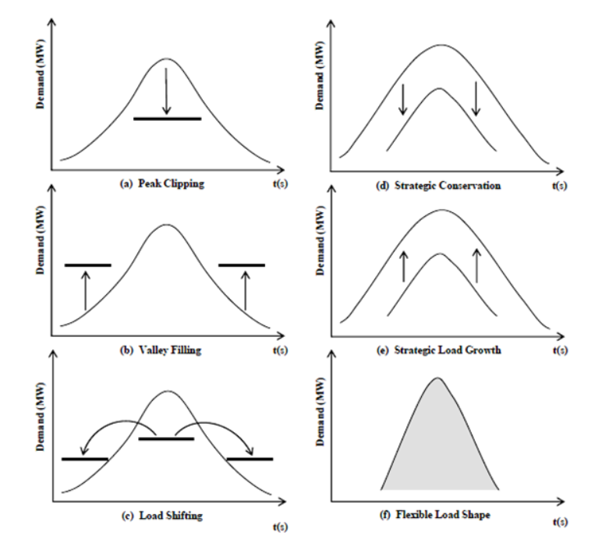
How does this effect the grid?
Gives Demand Side Management tools to address changing needs
Use of small scale nuclear reduces demand needed for renewable and lowers storage requirements
Allows for more efficient load shifting
Eric Mulshine University of Illinois Urbana-Champaign emulshine17@gmail.com
https://www.mepits.com/tutorial/447/electrical/demand-side-management-tutorial
Notes:
1:30
Talk about how this small scale nuclear and nuclear batteries would effect the DSM

Slide 8
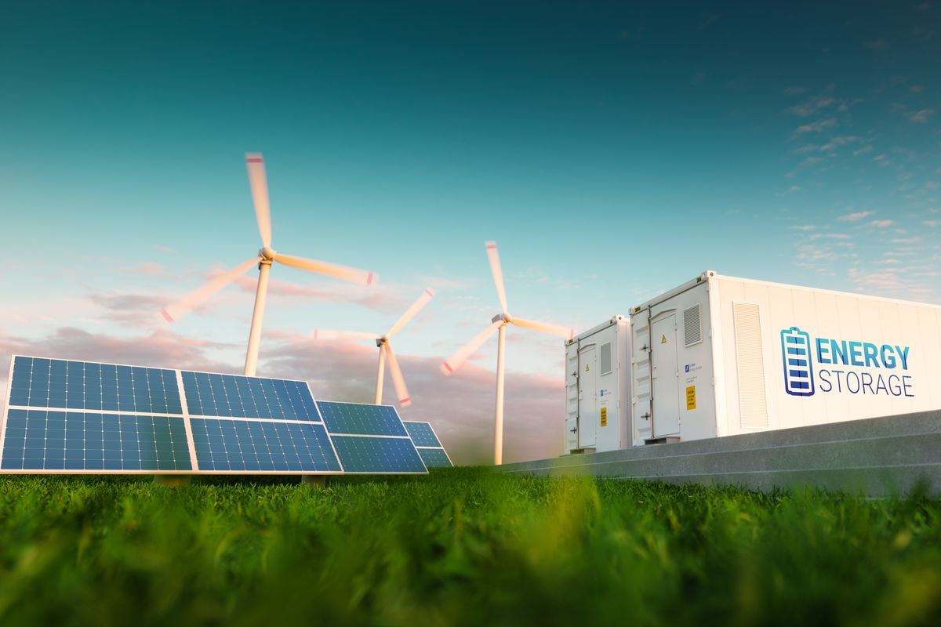
How this could be used?
Enables the use of storage and renewables
Small form factor allows for decentralized grid as well as local hydrogen production
Competes with coal to reduce carbon emissions
Useful as an emergency generators in critical facilities such as
Hospitals
Military Bases
Financial centers
Water Treatment plant
Eric Mulshine University of Illinois Urbana-Champaign emulshine17@gmail.com
Notes:
2:00
Talk o

Slide 9
Questions
Small Scale Nuclear Generation
Small Modular LWR creates adaptive energy solutions
Passive systems with built in redundancy increase safety
Economies of Scale reduce initial capital cost reducing financial risk
Well suited to grid management implementing a smart grid
Independent decentralized energy
Used as baseload in tandem with renewable and storage energy solutions
Nuclear Batteries
Betavoltaic power sources (BPS) function similar to solar PV
Radioisotope Thermoelectric Generators (RTG) use the decay to heat coolant
Well suited to remote applications
Little to no maintenance
Long lifetimes
High specific energy
Use in emergencies as a reliable form of power
Eric Mulshine University of Illinois Urbana-Champaign emulshine17@gmail.com

